Slide 1
Lecture #5
By: Aqib Rehman

Slide 2
outline
Recap & Virtual DOM
The React Router
Links & NavLinks
Programmatic Redirects
Higher Order Components
Using Axios
Route Parameters
Switch Tag
Importing Images

Slide 3
Recap & Virtual DOM

Slide 4
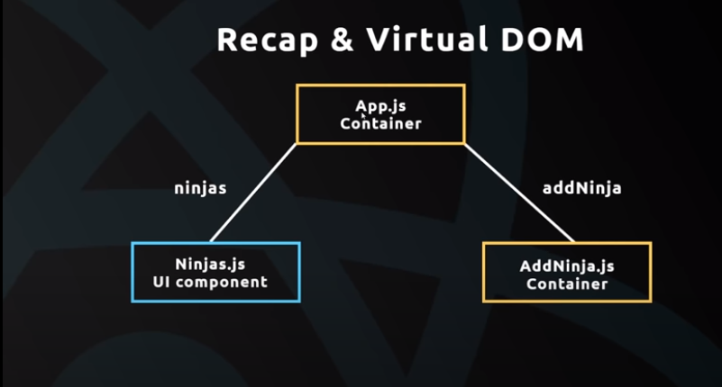

Slide 5
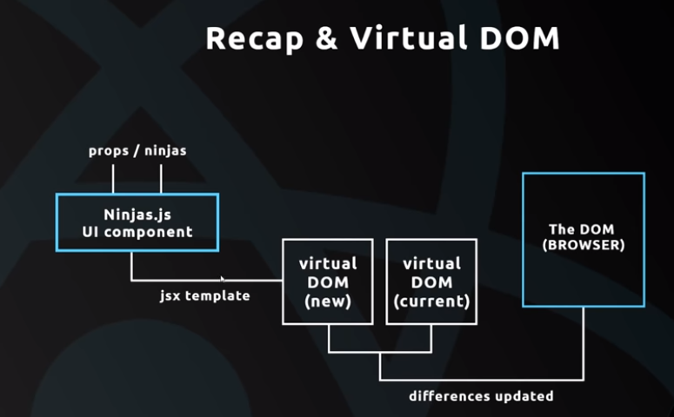

Slide 6
The React Router

Slide 7
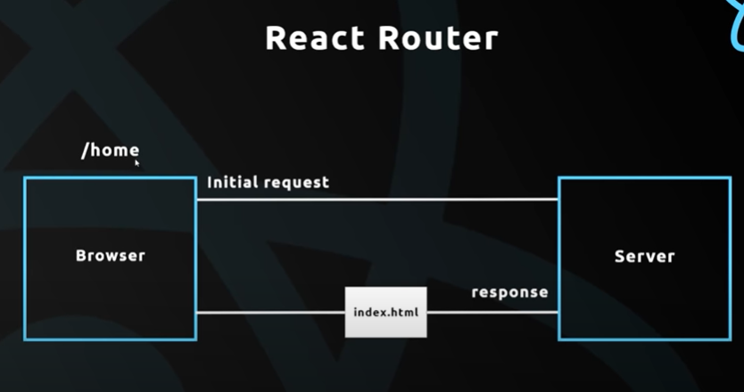

Slide 8
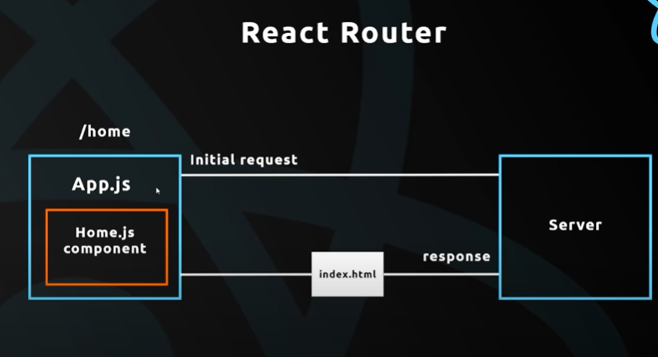

Slide 9
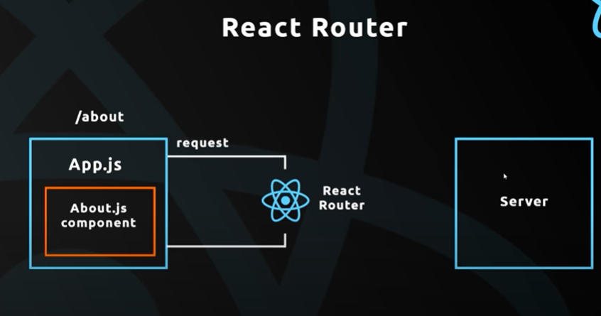

Slide 10
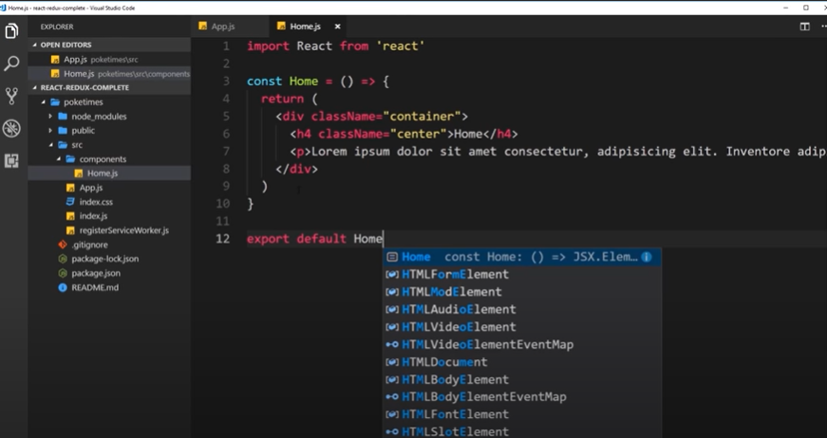

Slide 11
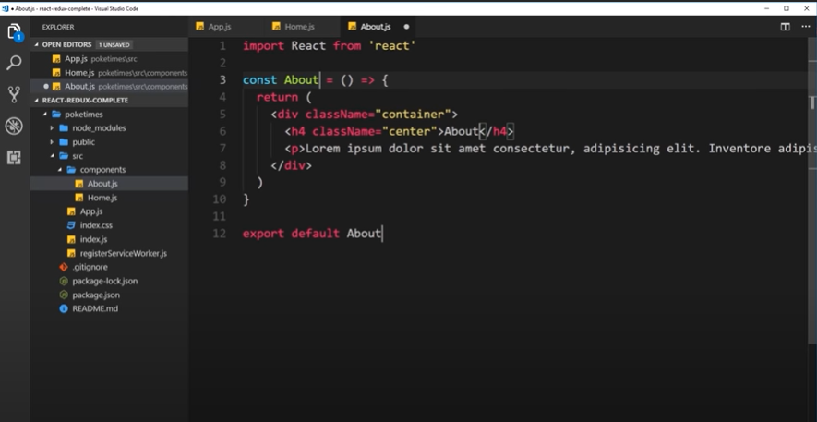

Slide 12
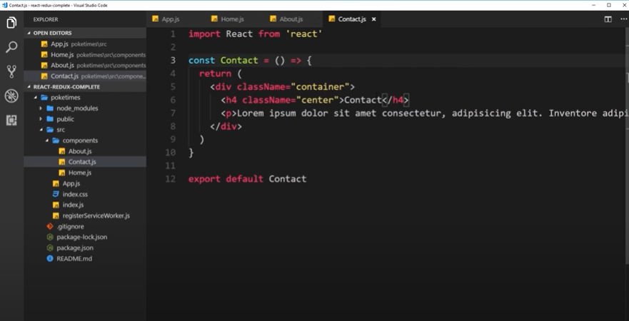

Slide 13
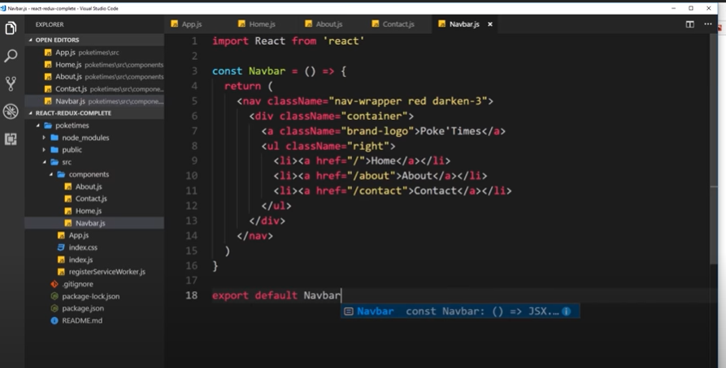

Slide 14
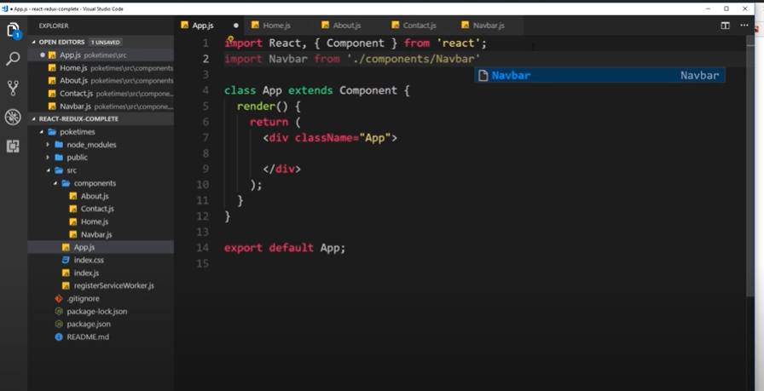

Slide 15
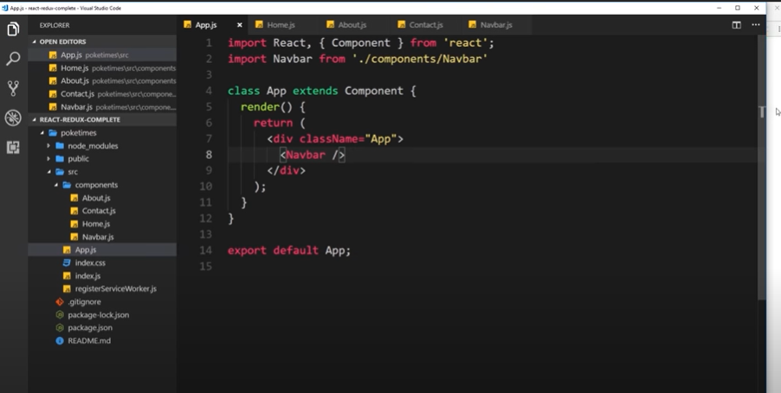

Slide 16
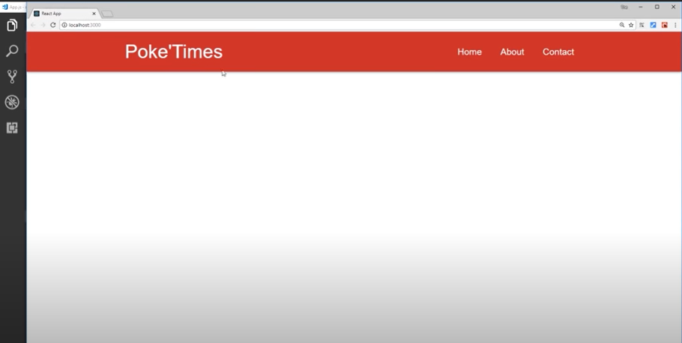

Slide 17
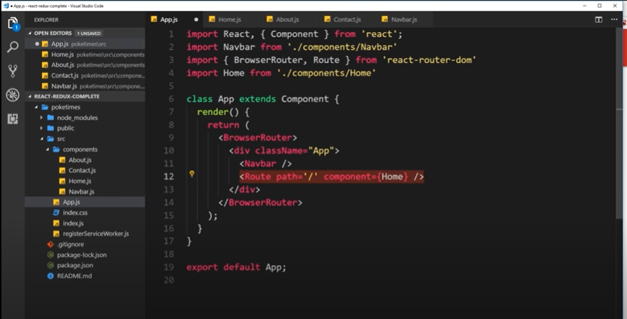

Slide 18
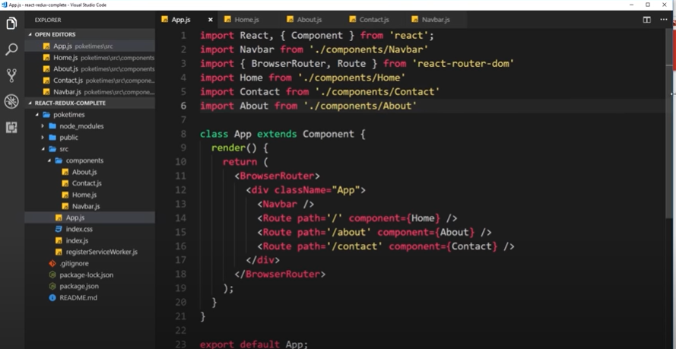

Slide 19
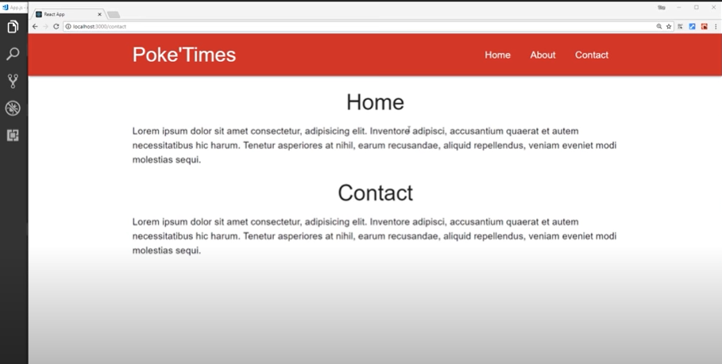

Slide 20
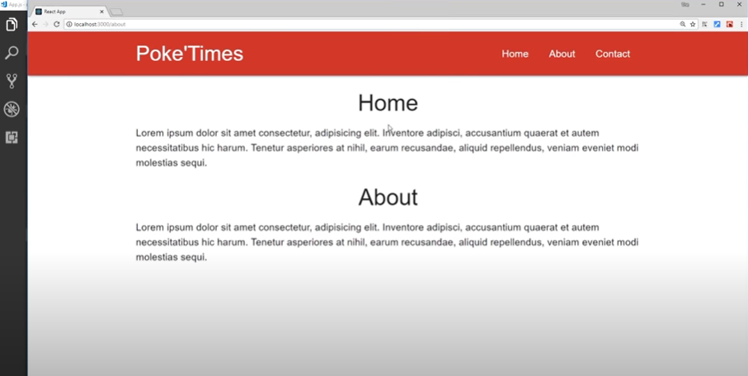

Slide 21
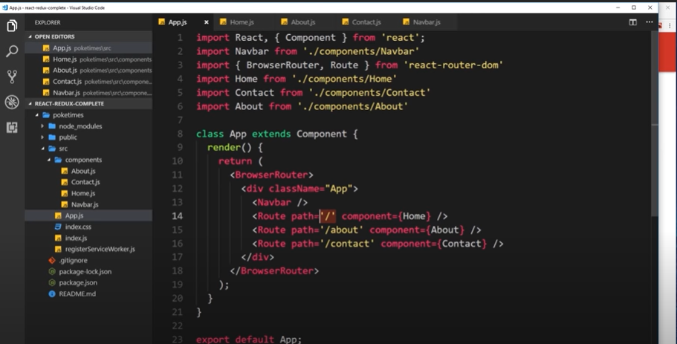

Slide 22
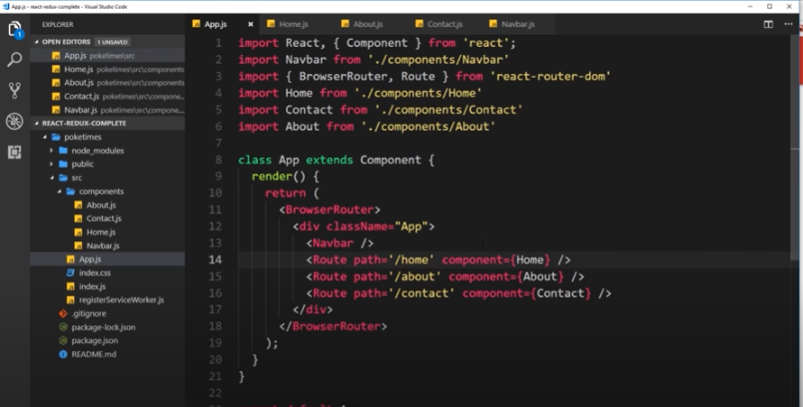

Slide 23
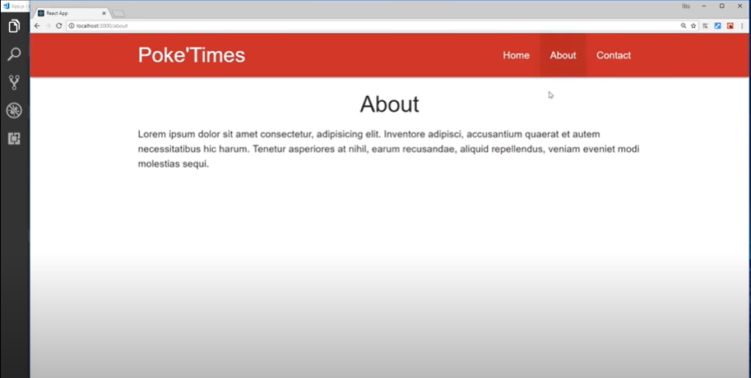

Slide 24
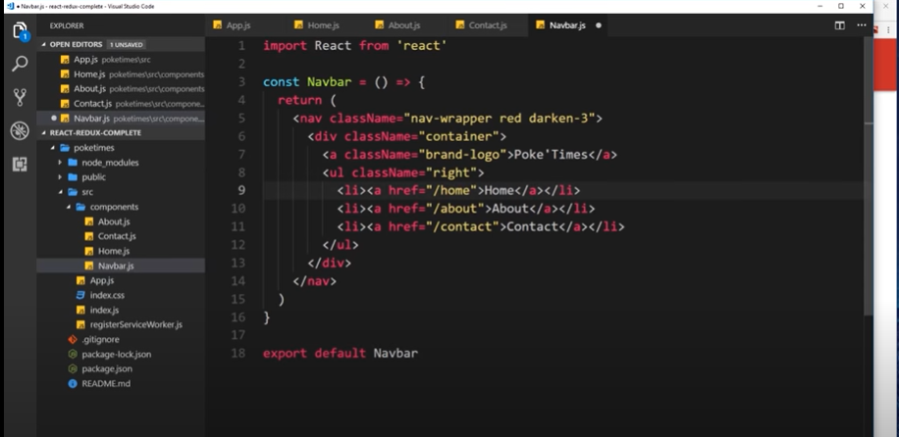

Slide 25
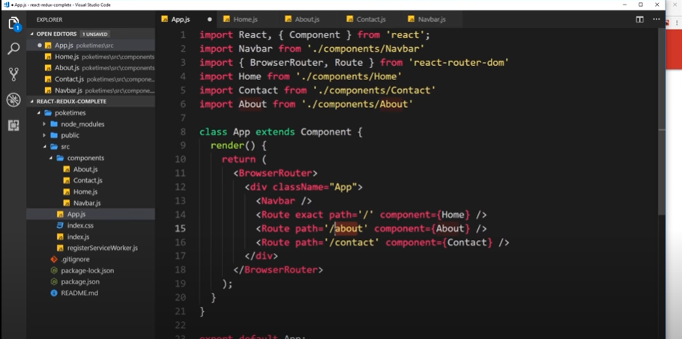

Slide 26
Links & NavLinks

Slide 27
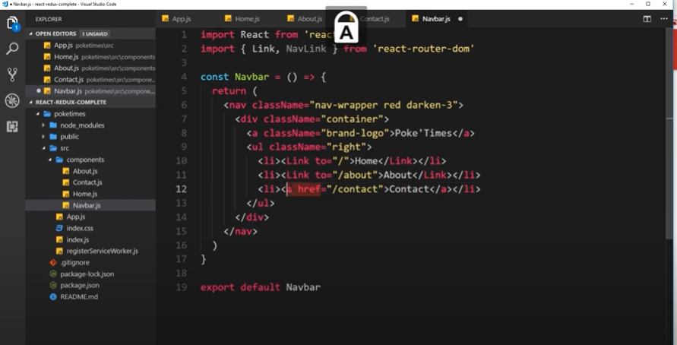

Slide 28
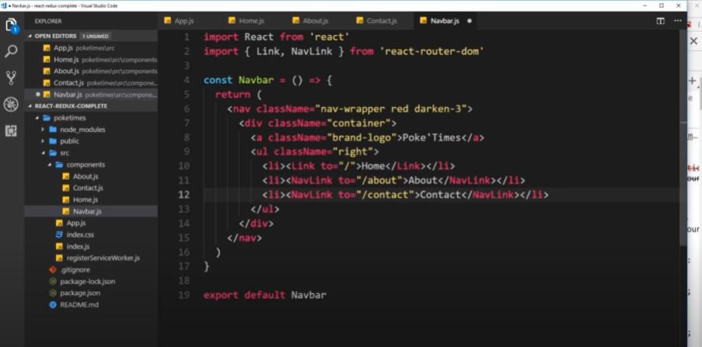

Slide 29
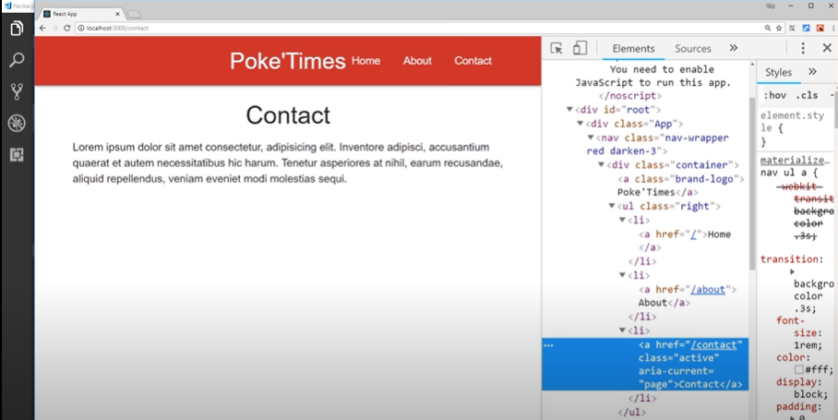

Slide 30
Programmatic Redirects

Slide 31
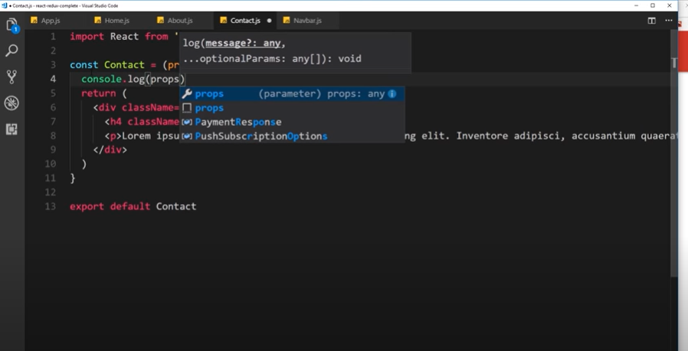

Slide 32
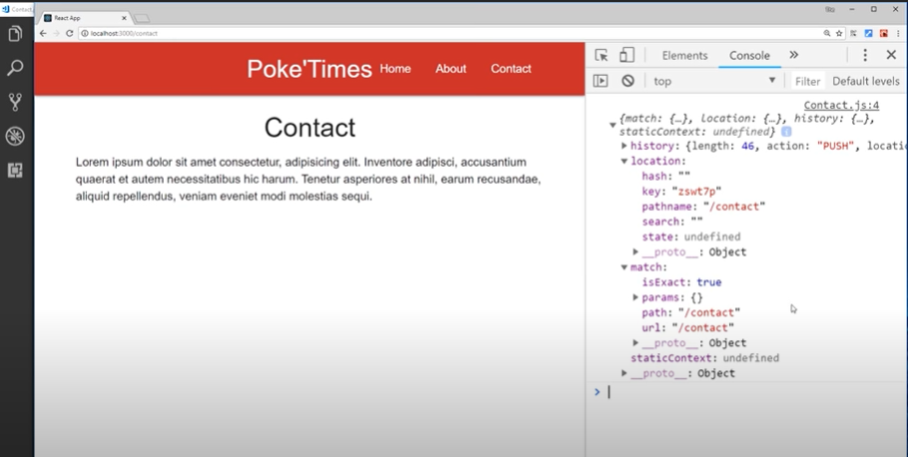

Slide 33
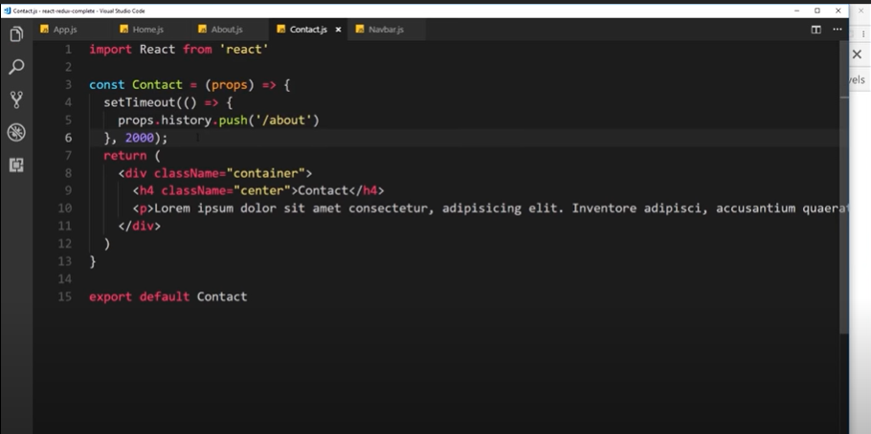

Slide 34
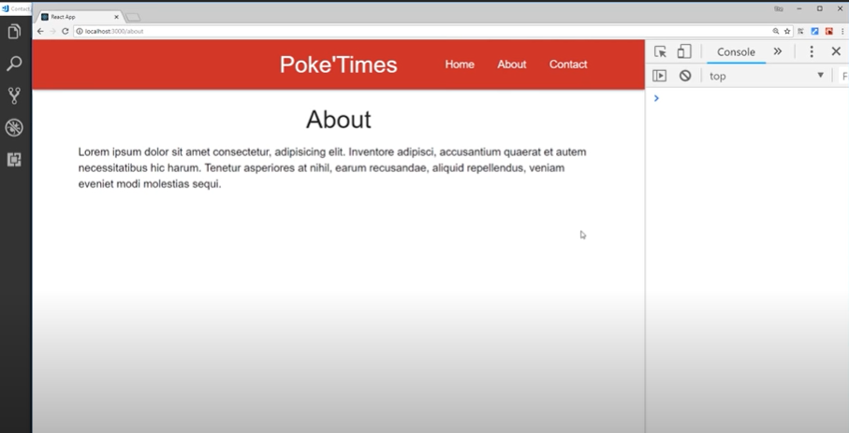

Slide 35
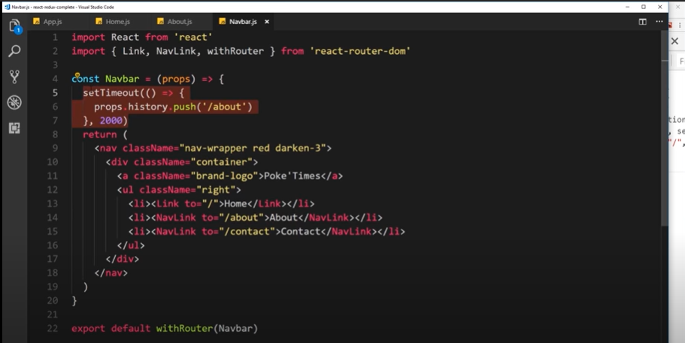

Slide 36
Higher Order Components

Slide 37
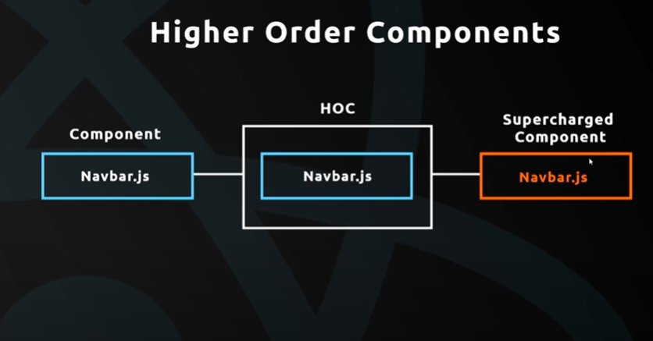

Slide 38
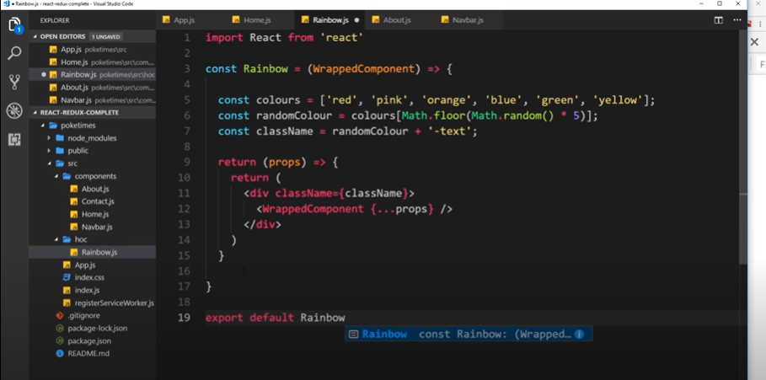

Slide 39
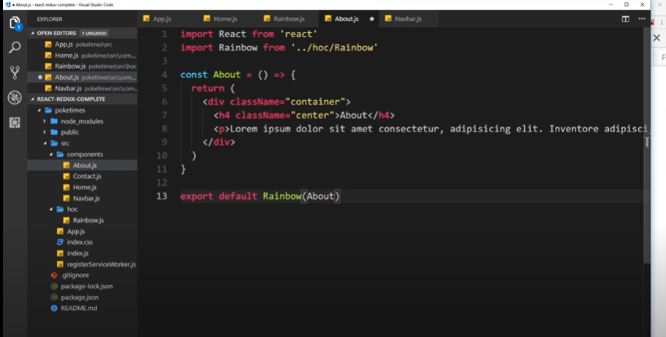

Slide 40
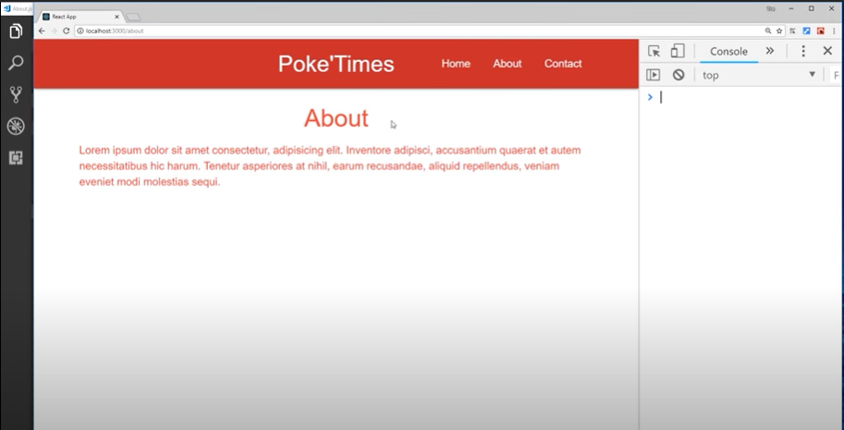

Slide 41
Using Axios

Slide 42
To get some data from REST APIs, your server, Firebase (direct database)
Lets get data from a testing REST API :
https://jsonplaceholder.typicode.com/posts

Slide 43
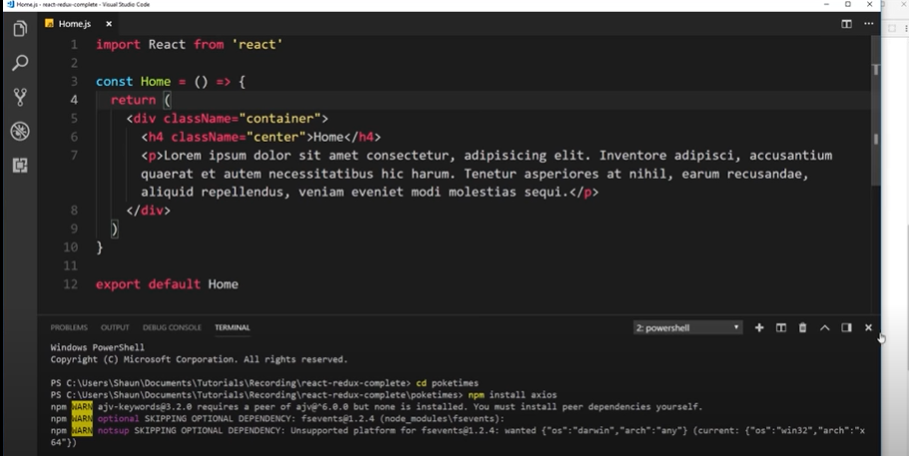

Slide 44
Component lifehooks only used in class based component
ComponentDidMount(){
}
component mounts using the useEffect hook in function based component.
useEffect(() => {
}, []);

Slide 45
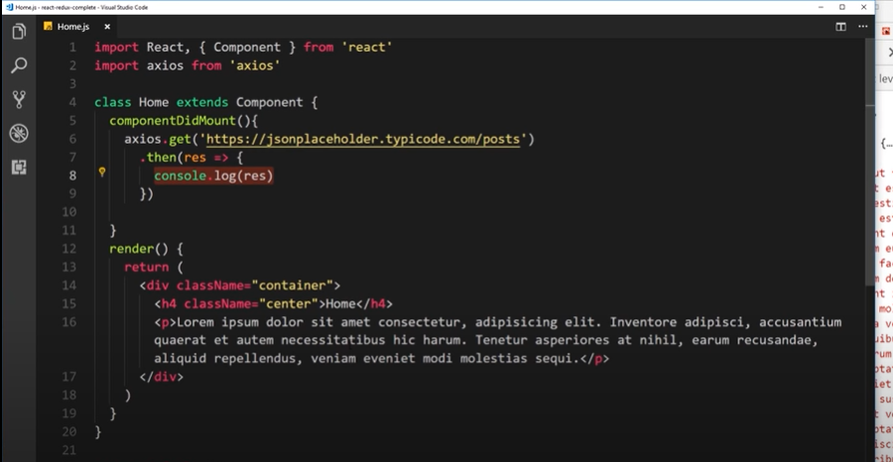

Slide 46
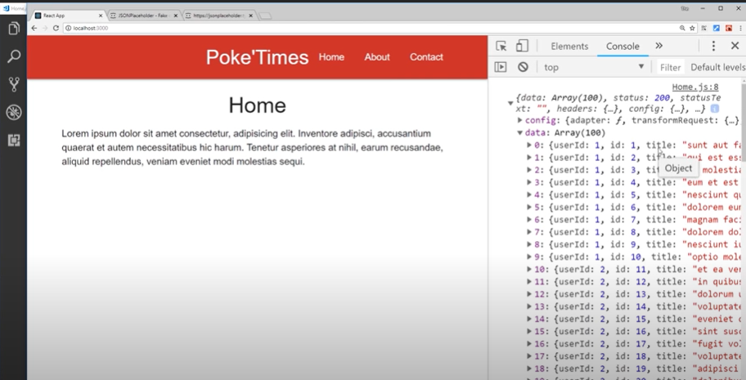

Slide 47
Showing data in some template
Lets have posts empty list
And add the res in that list

Slide 48
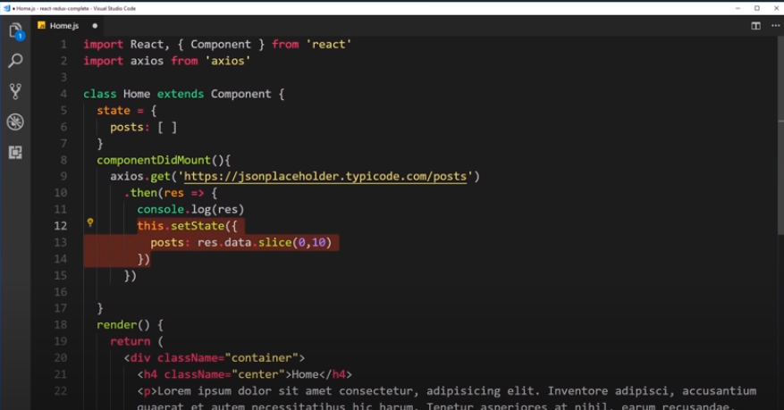

Slide 49
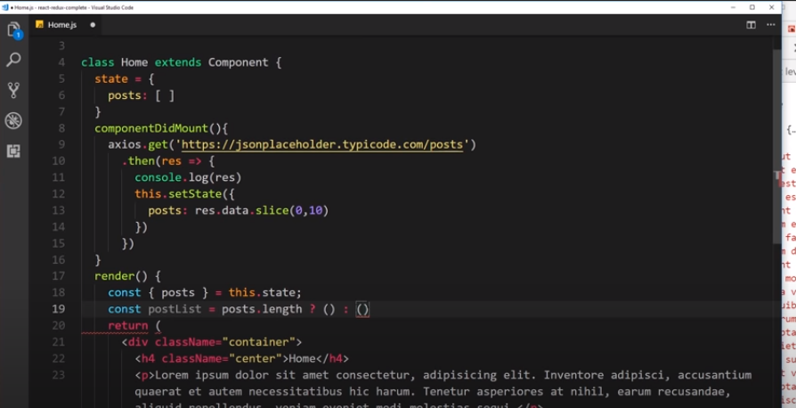

Slide 50
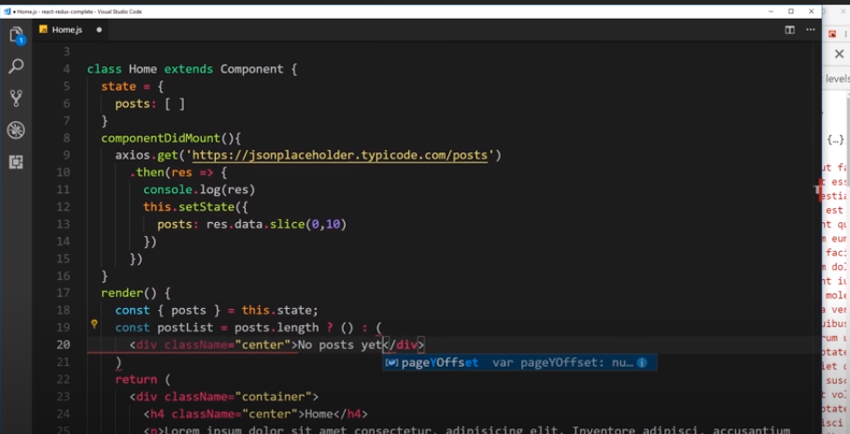

Slide 51
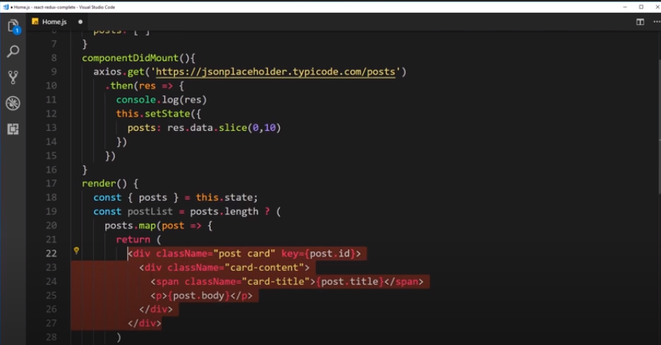

Slide 52
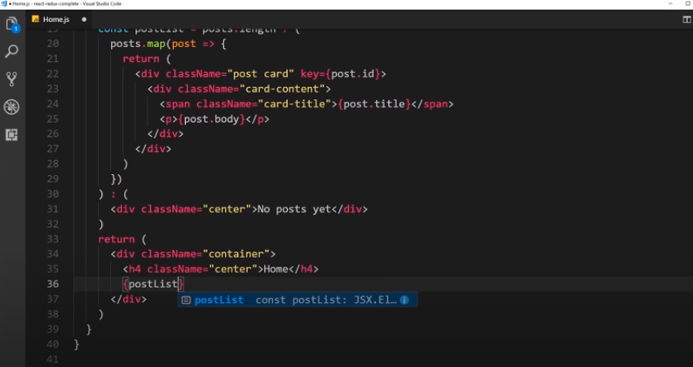

Slide 53
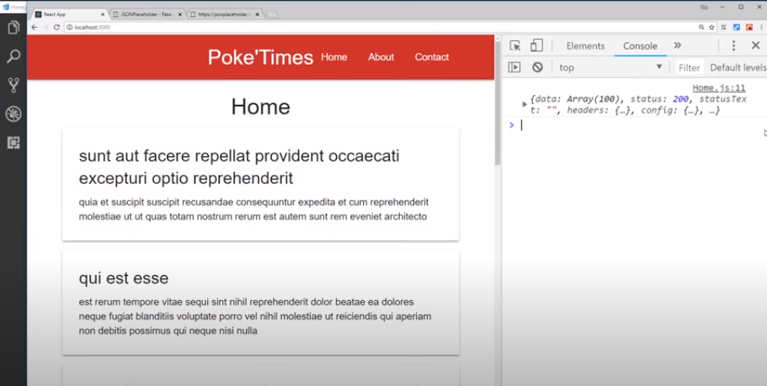

Slide 54
Route Parameters

Slide 55
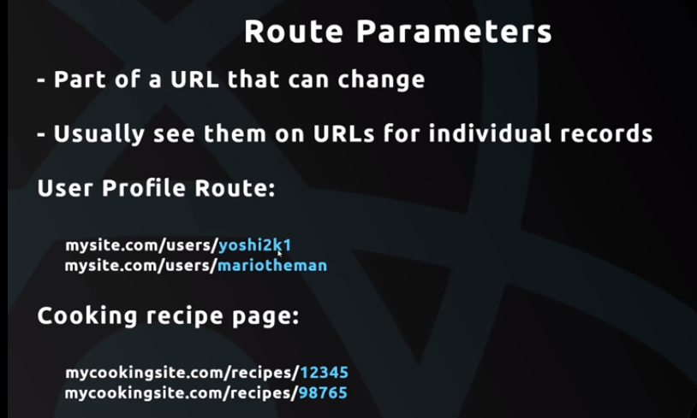

Slide 56
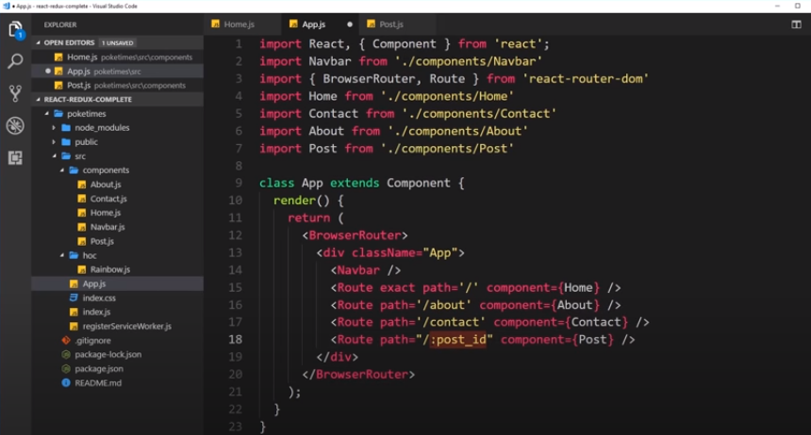

Slide 57
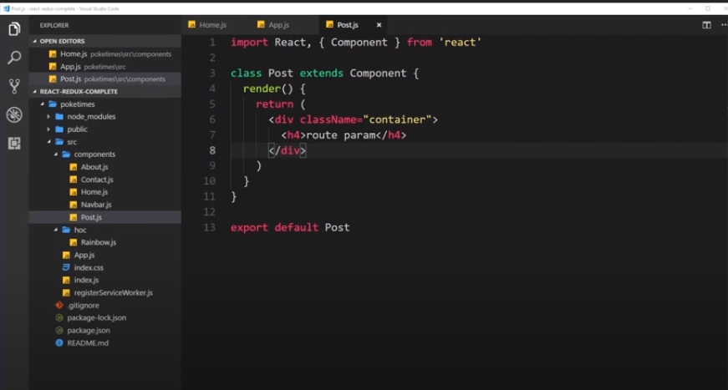

Slide 58
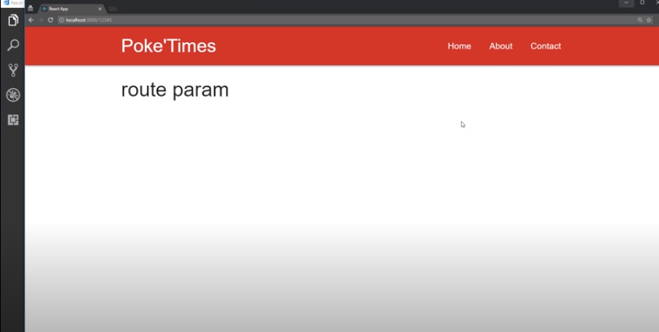

Slide 59
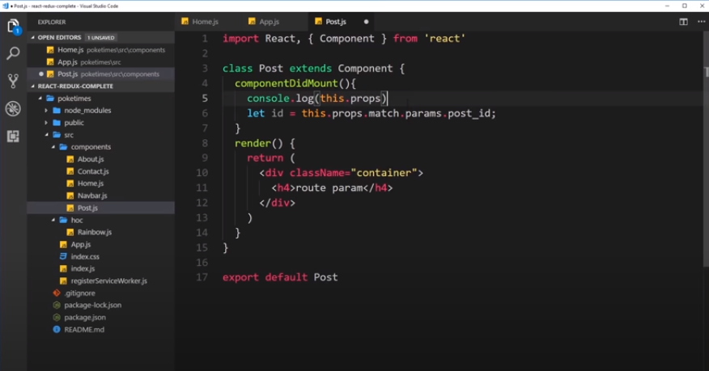

Slide 60
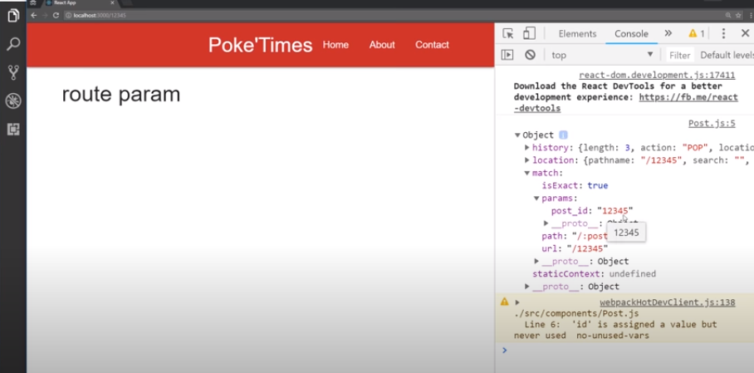

Slide 61
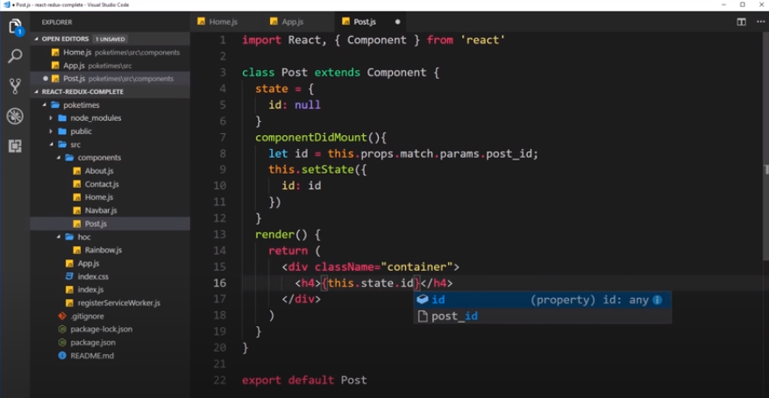

Slide 62
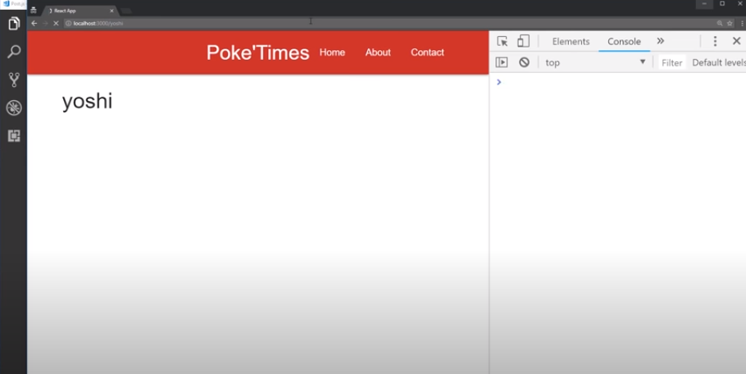

Slide 63


Slide 64


Slide 65


Slide 66


Slide 67


Slide 68


Slide 69


Slide 70


Slide 71


Slide 72


Slide 73


Slide 74
Switch Tag

Slide 75


Slide 76


Slide 77


Slide 78


Slide 79
Importing Images

Slide 80


Slide 81


Slide 82


Slide 83


Slide 84


